Slide 1
Numeric Functions and Recursion

Slide 2
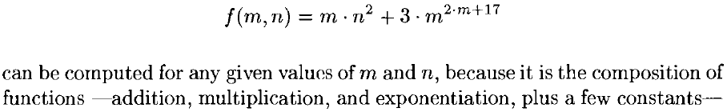


Numerical Functions
Functions from numbers to numbers
Eg.

Slide 3
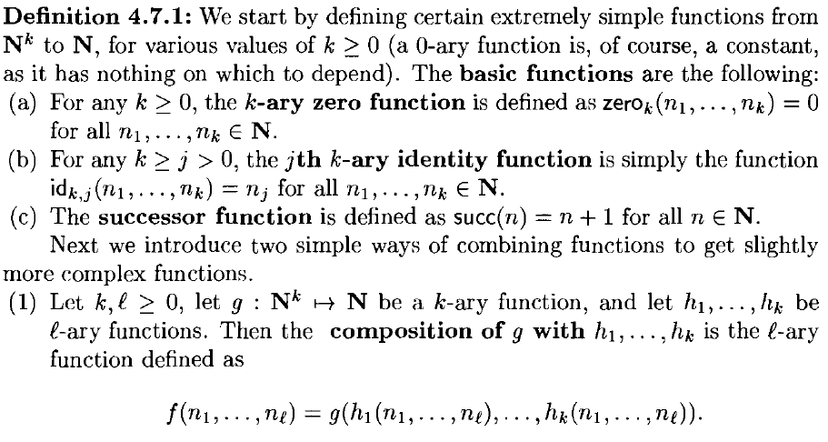
Basic Functions and Primitive Recursive Functions

Slide 4
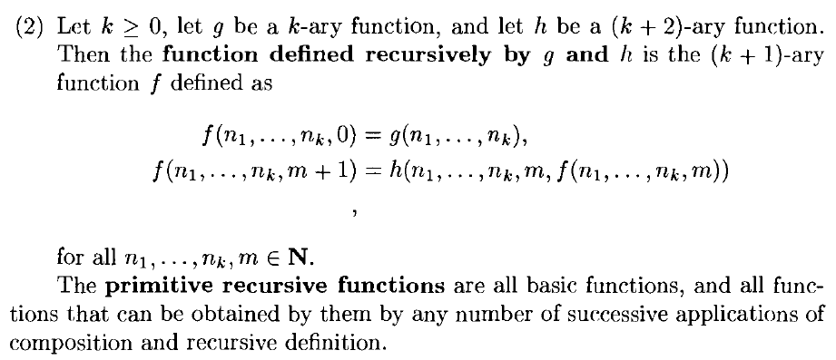
Basic Functions and Primitive Recursive Functions

Slide 5








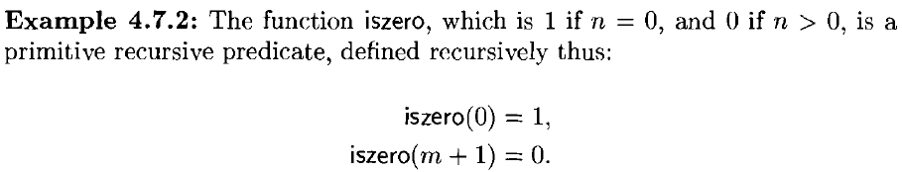
Examples

Slide 6
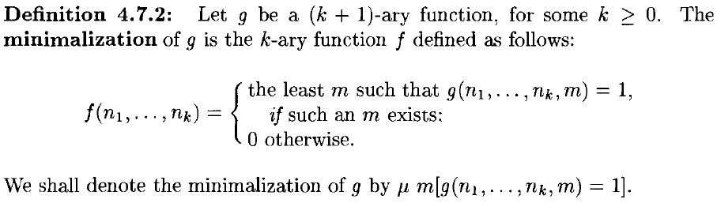
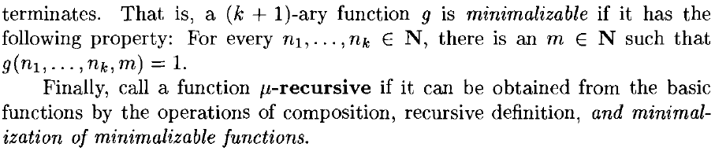
μ - Recursive Functions

Slide 7
μ - Recursive Functions
Example

